Slide 1

Foundational Skills Program
Course Title: Software Testing
Date: May 10, 2026
Md. Golam Mostofa
AI/ML-QA Engineer, Bizzntek Ltd

Slide 2
Outline
Introducing Evaluation dataset
Introducing DeepEval and Uptrain tool
Evaluation Setup
Environment Setup
Test EDEG chatbot using deepEval or Uptrain (automated and AI-Driven)

Slide 3
What Are Evaluation Datasets?
Definition: Curated collections of questions, prompts, and expected answers used to measure LLM capabilities across dimensions like knowledge, reasoning, truthfulness, and math.
📊
🎯
📈
Standardized
Multi-Dimensional
Benchmarking
Fixed question sets with ground-truth answers enable fair, reproducible comparisons across models and versions.
Cover diverse skills: factual recall, logical reasoning, coding, mathematics, common sense, and safety alignment.
Enable tracking model progress over time and comparing proprietary vs. open-source models objectively.

Slide 4
MMLU
Massive Multitask Language Understanding
57
15,908
4-way
STEM+
Subjects
Questions
MCQ Format
Coverage
Categories
Why Use MMLU?
🔬 STEM: Math, Physics, Chemistry, CS 🏛️ Humanities: History, Law, Philosophy 🧠 Social Sciences: Economics, Psychology 💊 Medical: Anatomy, Clinical Knowledge ⚖️ Professional: Law, Accounting, Finance
Gold-standard breadth benchmark for general knowledge
Widely adopted; enables cross-paper comparison
Reveals gaps across professional & academic domains
Hard enough to differentiate strong vs. weak models

Slide 5
TruthfulQA
Measuring Truthfulness in Language Models
Problem it Solves: LLMs often generate plausible-sounding but false answers — especially for misconceptions, myths, and conspiracy-prone topics. TruthfulQA directly targets these failure modes.
817 Questions
38 Categories
Dual Metrics
Hand-crafted adversarial prompts
Misconceptions & myths
Truthful & Informative
Questions designed so that humans would answer correctly but LLMs trained on text tend to fail due to imitative falsehoods.
Covers health, finance, law, conspiracy, fiction, politics — wherever false beliefs are commonly held.
Scores both whether an answer is true AND whether it's useful — a trivially safe 'I don't know' is penalised.

Slide 6
MathQA
Mathematical Reasoning Benchmark
Overview
Problem Categories
~37,000
Arithmetic & Algebra
35%
annotated math word problems
Geometry
18%
5-way MCQ
with detailed rationales
Probability & Statistics
22%
Derived from
AQuA-RAT dataset
Physics Word Problems
15%
Tests
multi-step arithmetic reasoning
Other Applied Math
10%

Slide 7
Other Notable Evaluation Datasets
🔗 HellaSwag
🔢 GSM8K
💻 HumanEval
Commonsense
Grade-School Math
Code Generation
70k sentence completion tasks testing situational commonsense reasoning. Uses adversarial filtering to make it challenging.
8.5k linguistically diverse grade-school math problems requiring multi-step arithmetic. Key test for chain-of-thought reasoning.
164 hand-crafted Python programming problems. Tests functional correctness: code must pass hidden unit tests.
🎲 BIG-Bench
🔭 ARC
📝 WinoGrande
Diverse Tasks
Science QA
Pronoun Resolution
Beyond the Imitation Game: 204 tasks from 132 institutions testing capabilities beyond standard benchmarks.
AI2 Reasoning Challenge: 7,787 science questions split into Easy and Challenge sets for deeper reasoning.
44k Winograd schema problems testing commonsense reasoning about pronoun references at scale.

Slide 8
DeepEval — Usage & Features
Key Features
Python
🧪 pytest Integration
from deepeval import evaluate from deepeval.metrics import AnswerRelevancyMetric from deepeval.test_case import LLMTestCase # Define the metric metric = AnswerRelevancyMetric(threshold=0.7) # Create test case test_case = LLMTestCase(
input=
"What is LangChain?"
actual_output=llm_response ) # Run evaluation evaluate([test_case], [metric])
Write evals like unit tests; run with deepeval test run
📊 Confident AI Dashboard
Visual UI to track regressions & compare runs
🔁 CI/CD Ready
Fail pipelines when metric scores drop below threshold
🤖 LLM-as-Judge
Uses GPT-4 or custom models to score open-ended answers
🔌 RAG Support
Full pipeline metrics: retrieval, faithfulness, recall

Slide 9
UpTrain
AI Quality Evaluation & Continuous Monitoring
Core Philosophy: UpTrain focuses on production-grade LLM observability, evaluating, monitoring, and improving AI pipelines continuously, not just at test time.
📡 Response Quality
🧠 Context Grounding
🔄 Conversation Eval
Scores completeness, conciseness, and relevance of generated text.
Checks if responses are grounded in provided context (critical for RAG).
Multi-turn conversation quality: coherence, satisfaction, topic drift.
📉 Drift Detection
🛡️ Safety & Bias
📋 Custom Operators
Monitors data drift and model degradation in production over time.
Detects harmful content, PII leakage, and demographic bias.
Write custom Python operators to embed domain-specific evaluation logic.

Slide 10
UpTrain — Usage & Dashboard
Platform Features
Python
🖥️ Self-Hosted Dashboard
import uptrain # Initialize the evaluator eval_llm = uptrain.EvalLLM(uptrain.Evals.RAG_WITH_CITATION, openai_api_key="sk-..." ) # Evaluate responses results = eval_llm.evaluate( data=[{ "question": "What is RAG?", "context": retrieved_docs, "response": llm_answer }] ) print(results)
Local web UI — no data leaves your infra
☁️ UpTrain Cloud
Managed SaaS with experiment tracking
📬 Slack Alerts
Real-time alerts when quality drops in prod
🔬 A/B Testing
Compare prompt versions with statistical rigor
🔗 LangChain/LlamaIndex
Native integrations with popular LLM frameworks

Slide 11
DeepEval vs UpTrain
Dimension
DeepEval
UpTrain
Primary Focus
Unit-test-style LLM evaluation
Production monitoring & observability
Integration
pytest, CI/CD pipelines
LangChain, LlamaIndex, REST API
Metrics Style
Pre-built + custom via G-Eval
Pre-built operators + custom Python
Dashboard
Confident AI (cloud)
Self-hosted or UpTrain Cloud
RAG Support
Full RAG metric suite ✅
Full RAG metric suite ✅
Alerting
Threshold-based test failure
Real-time Slack/email alerts
Best For
Dev/testing phase evaluation
Production quality monitoring

Slide 12
EDEG Chatbot Test automation Architecture
Start from main function
Checking test file available or not
Result folder checking
Launch app in Chrome browser
Wait for ready
Put prompt into the chatbot
Get response
Test response by the Mistral LLM
Same test result

Slide 13
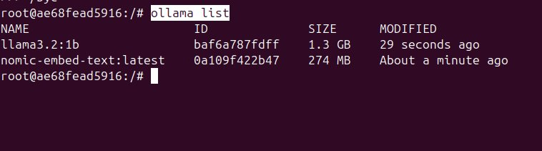




Pre-Requisites
Key Features
Ollama install
Chrome-browser
Llama3.2:1b
Nomic-embed-text

Slide 14

Environment Setup For EDEG Chatbot
1
Create Virtual Environment & Active
2
Install Requirements
python –m venv venv
venv\Scripts\activate
pip install –r requirements.txt
Download the EDEG Chatbot first
Install the Python packages.
3
Run the Chatbot
4
Test the Chatbot
streamlit run app.py
venv\Scripts\activate
python fill_test_sheet.py
Navigate: http://localhost:8501/
Run the test.

Slide 15
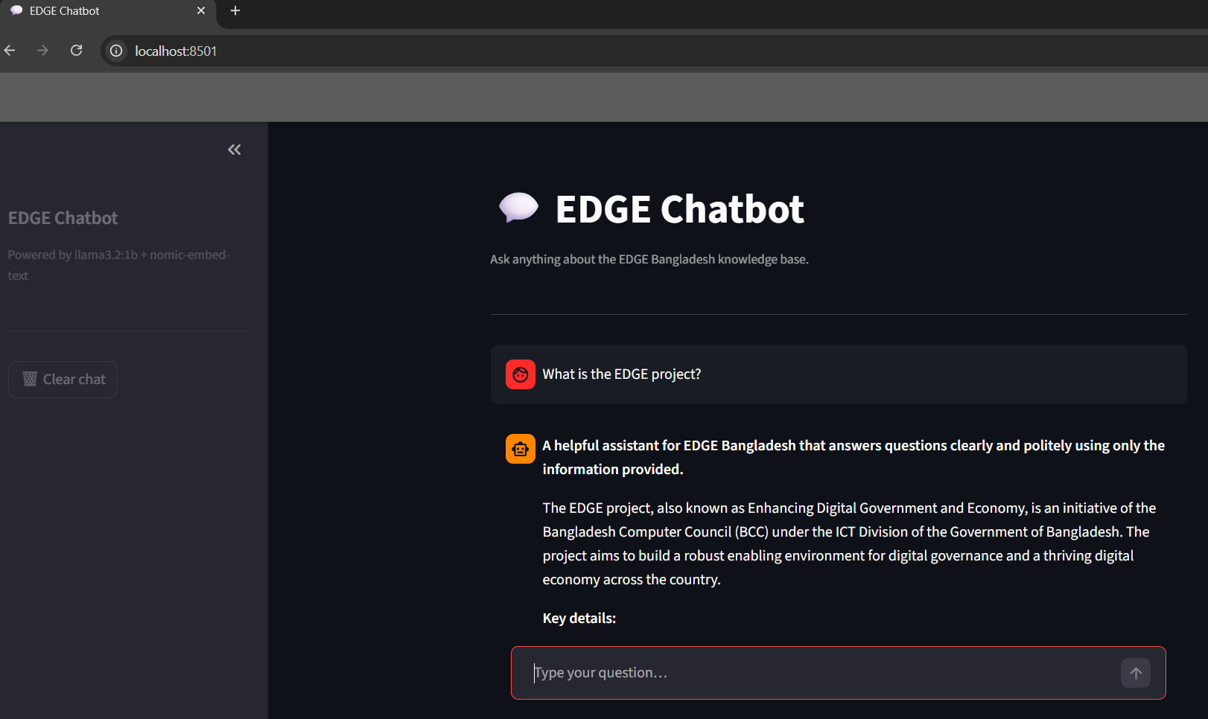
Test EDGE Chatbot Automatically

Slide 16
Q&A
Any Questions?

Slide 17
Thanks
Md. Golam Mostofa
golam.mostofa@bizzntek.com

